Slide 1

Patient and public involvement in Artificial Intelligence
Soumya Banerjee
University of Cambridge

Slide 2
Personal history
Worked in computational biology
Have a PhD in Computer Science
Worked in cell biology, clinical informatics, etc.
Also worked in supply chains (with industry)
Drug development (with industry)

Slide 3
Background
The general public is disconnected from AI and there is mistrust
We do not trust what we do not understand

Slide 4
Risk of AI?
Critical stakeholders and end-users of AI or those who are impacted by AI are not involved in
Understanding AI models
AI model building

Slide 5
Human-AI Collaboration
The role of lived experience is very important
Frequently neglected in science
Patients just become data points

Slide 6

One fine day …

Slide 7
Patient comes up with research question!
Patient came up with hypothesis
Value of lived experience
Researchers (like me) frequently do not know what it feels like to have a disease

Slide 8
Steps
Recruiting patients and forming a RAG
Problem formulation and hypothesis generation
Building trust in data storage infrastructure
Addressing concerns about big data
Discrimination and bias in AI
Debunking myths about AI
Understanding a simplified model
Understanding AI models more broadly
Designing interfaces with patients
Banerjee et al., Patterns, 2022

Slide 9

The case of lithium
Data from hospital electronic healthcare records
EPIC (laboratory tests, diagnosis codes prescriptions)
Meditech (laboratory tests)
Banerjee et al., Patterns, 2022

Slide 10
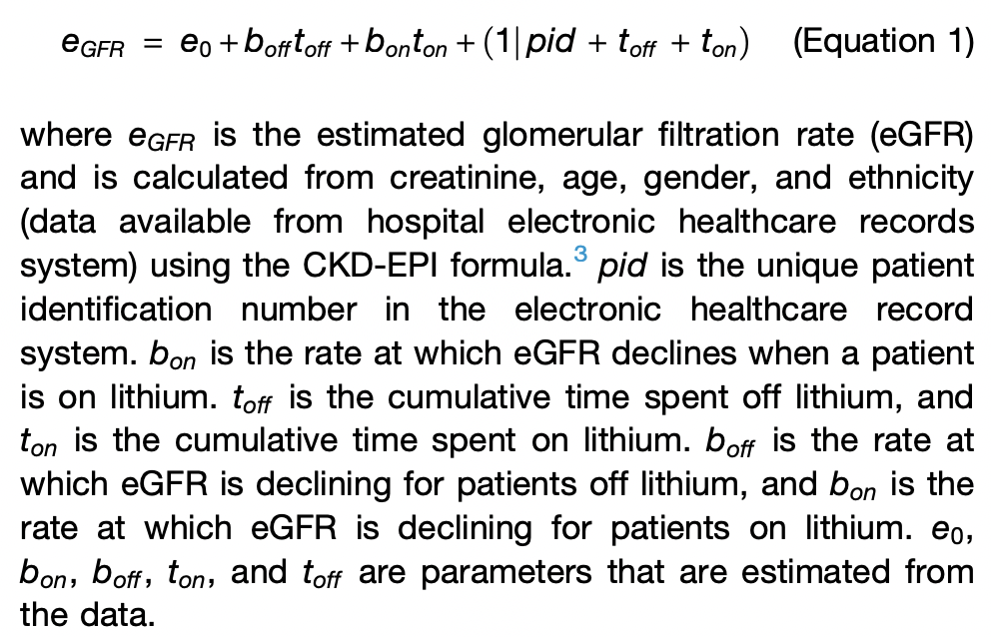
The case of lithium
Banerjee et al., Patterns, 2022

Slide 11
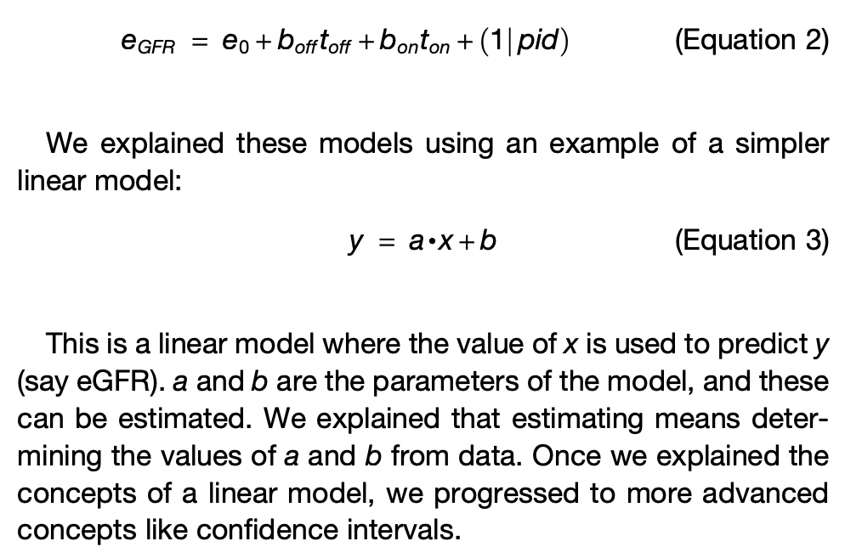
The case of lithium
We also took the time to explain how to build statistical models.
For example, we tried other, simpler formulations before we arrived at the final model. This showed patients how researchers always incrementally build more complex models
Banerjee et al., Patterns, 2022

Slide 12
The case of lithium
However, using these data on a few thousand patients, the results were inconclusive.
This motivated the need to go back to the RAG and explain the need for more data.
We took feedback from patients as to whether we should apply for access to more data.
We also built a tool that explains how, in some cases, having more data can help in estimating parameters of statistical models
This process of performing research and getting inconclusive results also showed patients how research always takes time and can lead to unexpected roadblocks
Banerjee et al., Patterns, 2022

Slide 13

Data Privacy
How can big data help?
Privacy and security explained
Difficult to get access to data even for researchers
Saga of data access …..
Banerjee et al., Patterns, 2022

Slide 14

Bias in Algorithms
Bias in face detection
Banerjee et al., Patterns, 2022

Slide 15
Tools for outreach
Tools for involvement and outreach
AI models that can be trained, run, and visualized in the Web browser, like the Teachable Machine
An AI model that runs in the Web browser and uses a webcam to detect facial expressions
A set of videos that demonstrate what AI can and cannot do
A resource of myths about AI
https://github.com/neelsoumya/ai_outreach
https://github.com/neelsoumya/ai_outreach

Slide 16
Communicating caveats
At this stage, we also communicated to the patients a number of caveats. Lithium is an effective medication for managing bipolar disorder and the chances of patients developing renal complications is quite small.
The benefit of discontinuing lithium should be carefully weighed against the risk of relapse of the psychiatric disorder, as has been documented in case studies and suggested in meta-analysis studies.
Our work may lead to randomized controlled trials to test the hypothesis that discontinuing lithium may help recover kidney function in patients with bipolar disorder.
Banerjee et al., Patterns, 2022

Slide 17
The case of developing an xAI technique
Patients with schizophrenia
xAI technique
Visual and textual explanation
Workshop

Slide 18
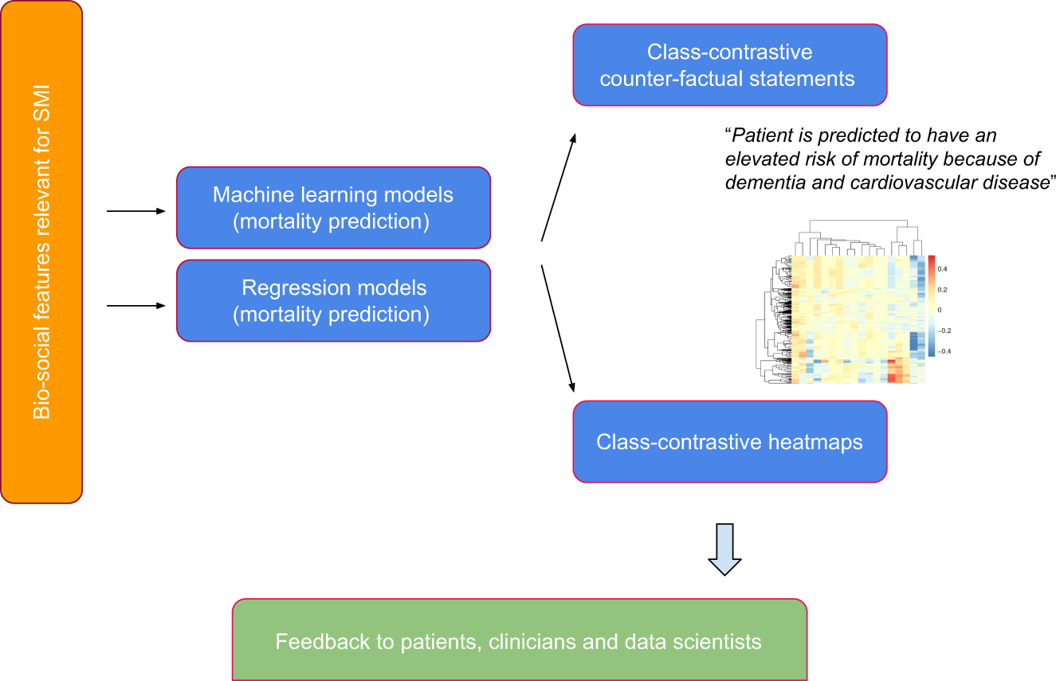
The case of developing an xAI technique
Banerjee et al., NPJ Schizophrenia, 2021

Slide 19
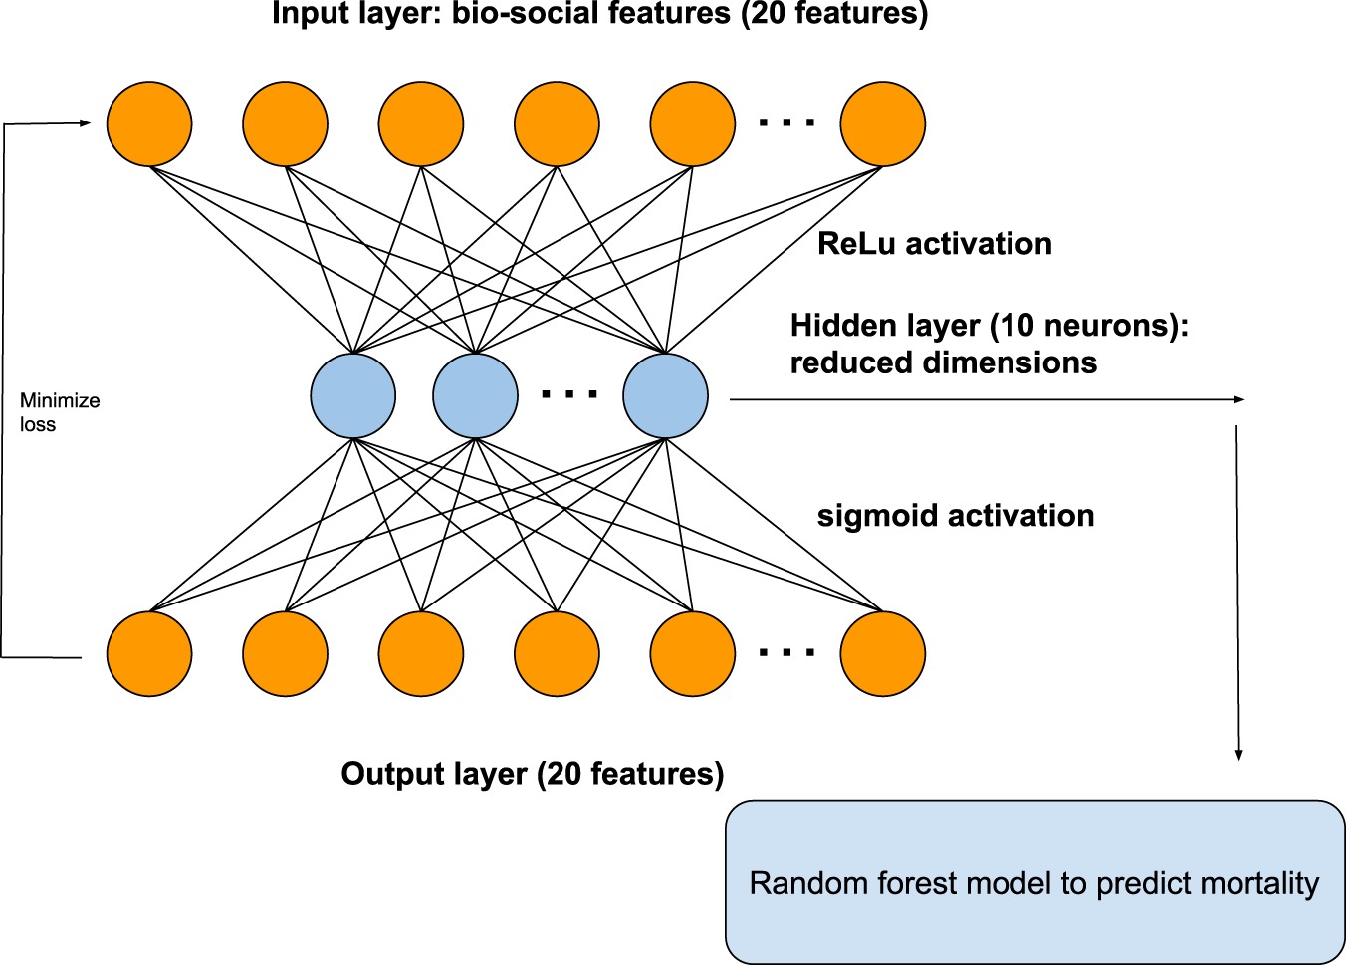
The case of developing an xAI technique
Banerjee et al., NPJ Schizophrenia, 2021

Slide 20

The case of developing an xAI technique
Banerjee et al., NPJ Schizophrenia, 2021

Slide 21
Patient perspective
Patients and carers have important research ideas about how best to improve quality of life, manage symptoms, offer existing treatments, or develop new interventions.
Often these ideas differ from those prioritized by academia or the pharmaceutical industry. Here is why two members got involved in research in our group:
"I decided to join the group to help make a difference using my experience with a mental health condition, in my case being diagnosed with bipolar in 2003. To offer and share ideas and tips in what helps me and also share my experience to help research in the future."
“I was excited when I saw the invitation to join this group. Using more extensive data can potentially answer many vital questions that an 8-week drug trial simply cannot. As a service user I was keen to see how we can be involved.”
Banerjee and Griffiths, AI & Society, 2023

Slide 22
Limitations
Costly to do
Time-consuming
Researchers not incentivized (does not count towards REF or tenure)
Quantitative training for patients
Long-standing collaborations required and trust
Takes time
Efficacy? How do we know if this works?
Human factors study
Banerjee and Griffiths, AI & Society, 2023

Slide 23
Systemic issues
Researchers are not incentivized to do PPI or outreach
Structural inequalities and power hierarchies in academia
Risky to work in this area (especially for early career researchers)
Banerjee and Griffiths, AI & Society, 2023

Slide 24
Why inform the public?
Public needs to be more informed about AI
More science awareness needed
COVID vaccine hesitancy
Fake news/misinformation
Resources
https://github.com/neelsoumya/ai_outreach

Slide 25
Why inform the public?
Public needs to be involved
Netherlands (benefits fraud detection system)
Fujitsu scandal in UK
Monitoring (and human rights violation) of Uyghurs in China
Citizen’s jury
Involving the public and end-users
May lead to trustworthy AI systems

Slide 26

We do not trust what we do not understand
Created with DreamUp AI

Slide 27
Solutions
Allow the public to build models and develop their own understanding
Power to the people
AI of the people, by the people, for the people
Citizen jury
Applicable to areas beyond healthcare

Slide 28
Solutions
Incredibly hard to do this kind of interdisciplinary participative science
Need more scientists who are cross-trained
clinicians who can think quantitatively
scientists who can work with patients, etc
Need patients who are quantitatively trained
Notes:
Incredibly hard to do. We had lots of specialists who were cross trained

Slide 29
The Power of Curiosity
Let people/patients explore models on their own
https://github.com/neelsoumya/ai_outreach

Slide 30
Summary
Outlined case studies and a methodology of how modern data science can be applied to healthcare where data scientists, clinicians, and patients work together.
The strategy of co-designing AI algorithms with patients is a balanced approach. This can help set more realistic expectations for all stakeholders since conventional narratives of AI revolve either around dystopia or limitless optimism.
We hope that AI research in healthcare can be adopted faster if humans slowly build up trust in machines, over repeated and carefully calibrated interactions. May help build trustworthy AI.
Patients, data scientists, and healthcare workers can work together, thus benefiting patients.

Slide 32
Papers and Resources
Patient and public involvement to build trust in artificial intelligence: a framework, tools and case studies, Soumya Banerjee, Phil Alsop, Linda Jones, Rudolf Cardinal, Patterns 3(6):100506, 2022
Involving patients in artificial intelligence research to build trustworthy systems, Soumya Banerjee, Sarah Griffiths, AI & Society, 2023
A class-contrastive human-interpretable machine learning approach to predict mortality in severe mental illness, Soumya Banerjee, Pietro Lio, Peter Jones, Rudolf Cardinal, Nature Partner Journal Schizophrenia, 7, 60, 2021
https://github.com/neelsoumya/ai_outreach
neel.soumya@gmail.com

Slide 34


Slide 35
Current Trends and Applications
Deep learning
Generative AI
Applications in Healthcare, Finance, Autonomous Systems

Slide 36
Risks of AI
Ethical considerations
Bias
Data privacy
Impact on jobs
Systemic effects on our planet

Slide 37
Summary

Slide 38
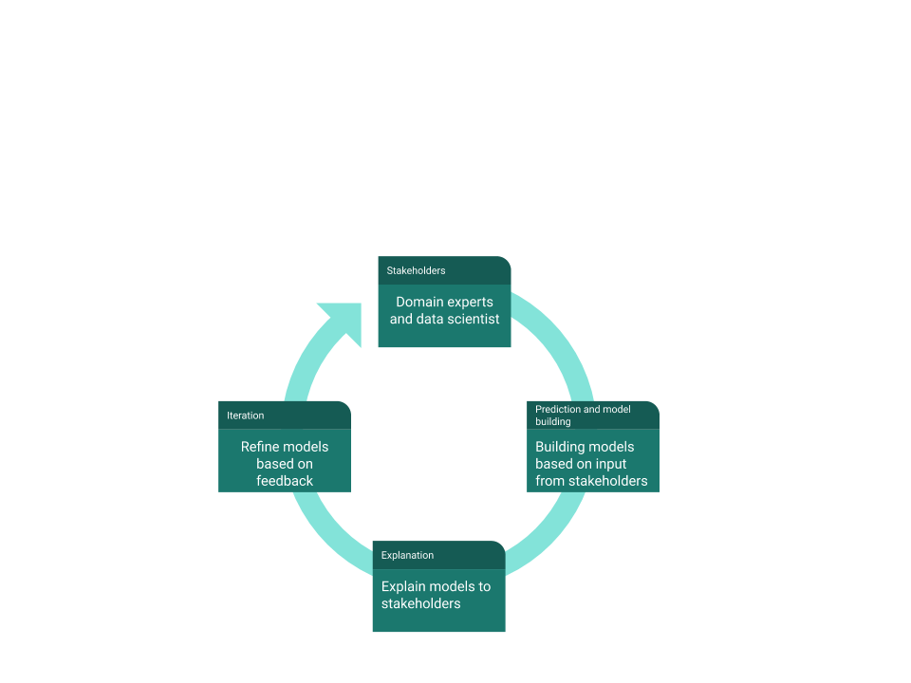
Research and teaching philosophy

Slide 39
The Importance of Collaboration

Slide 40
Personal Experiences in AI

Slide 41
Importance of Asking Questions

Slide 42
Learning from Setbacks

Slide 43
Value of Teamwork and Networking

Slide 44
Balancing Theory and Practice

Slide 45
Combining Learning with Practical Experience

Slide 46
Looking Ahead

Slide 47
Impact of AI on Global Challenges

Slide 48
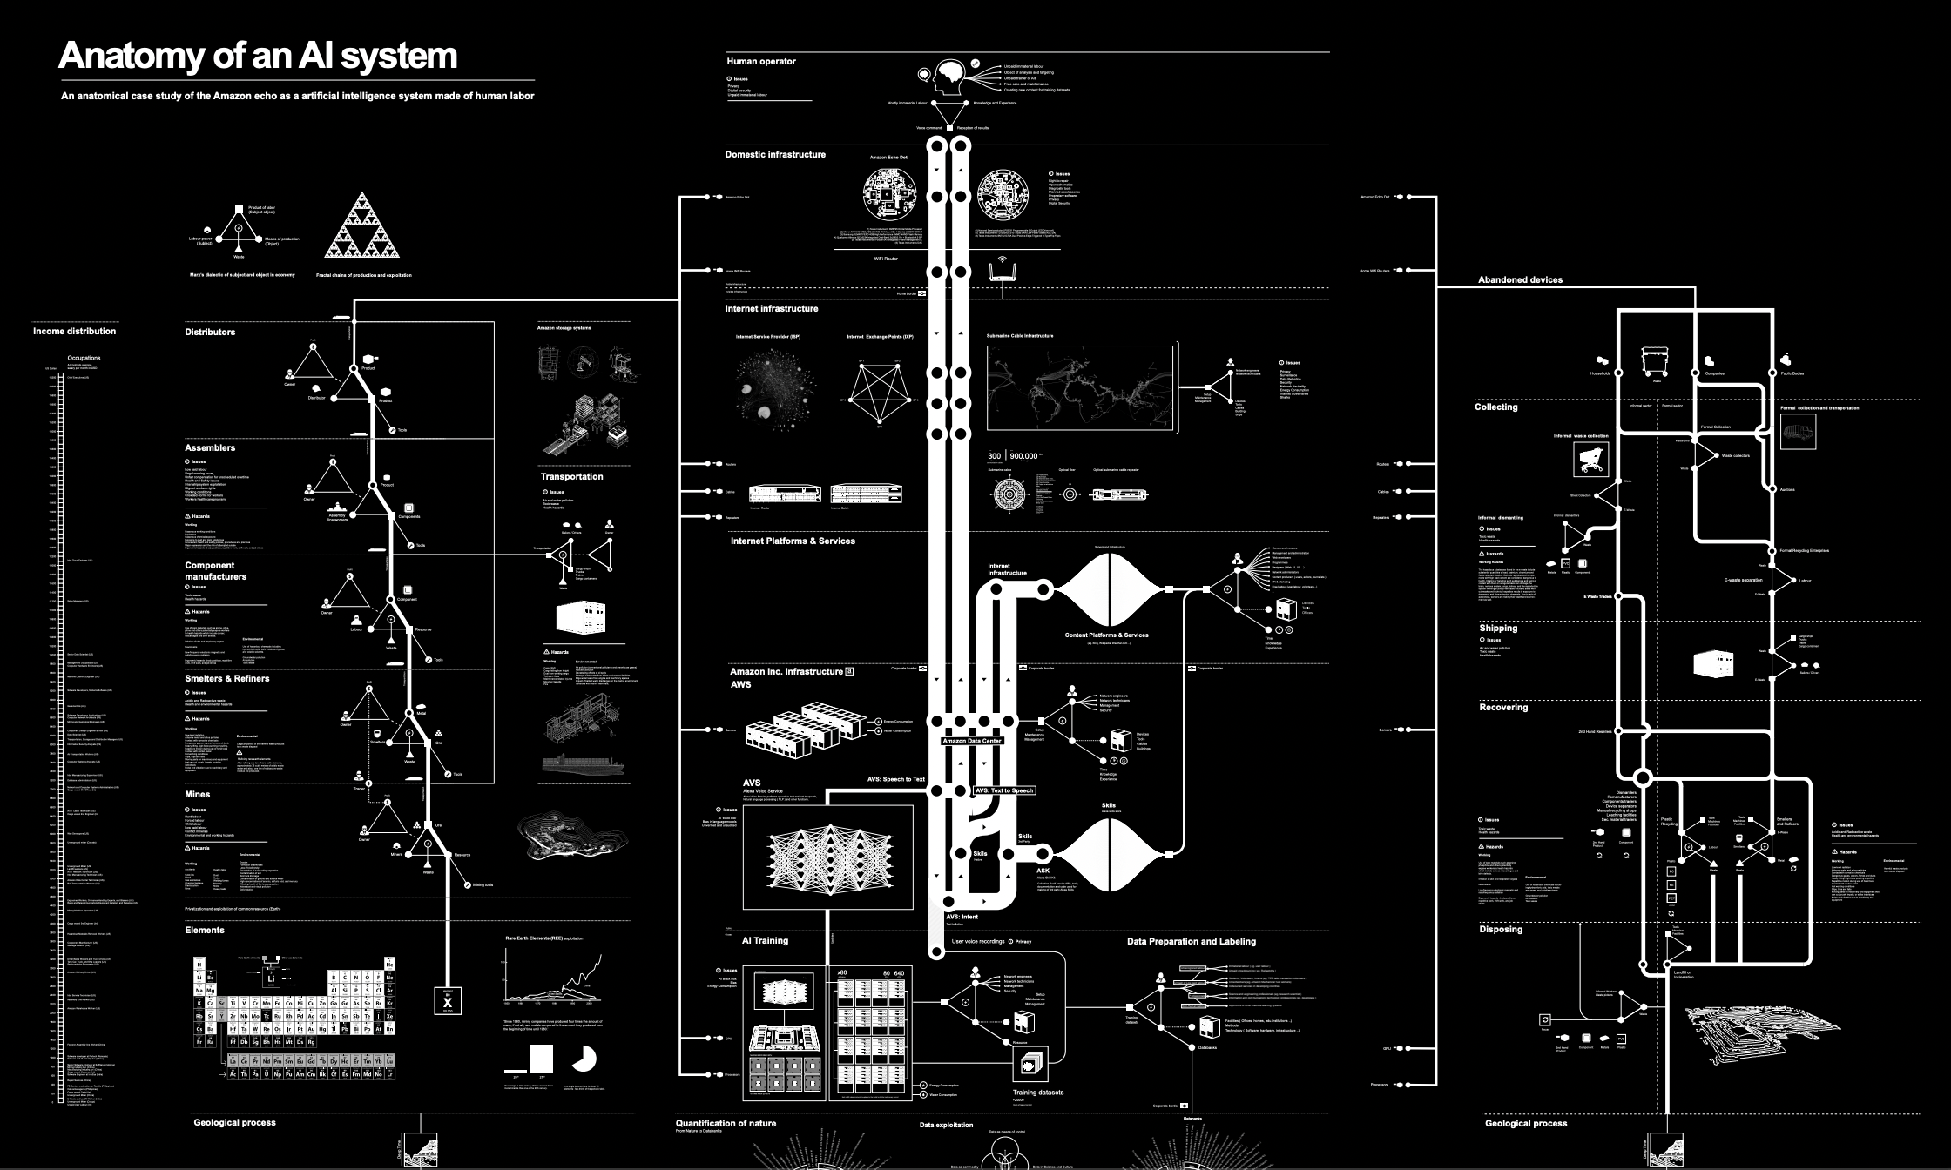
Other AI risks

Slide 49
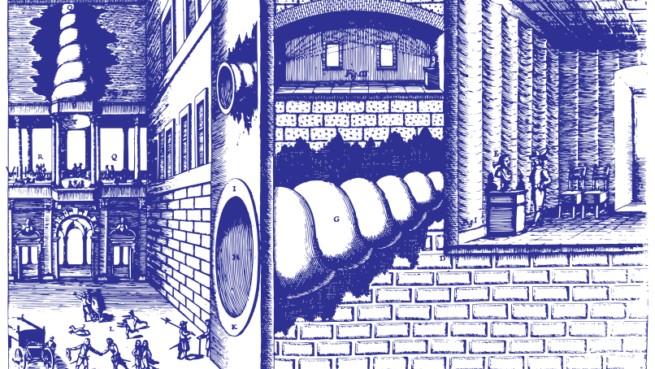
Other AI risks
Notes:
In 1673, the Jesuit polymath, Athanasius Kircher, invented the statua citofonica – the ‘talking statue.’ K

Slide 50
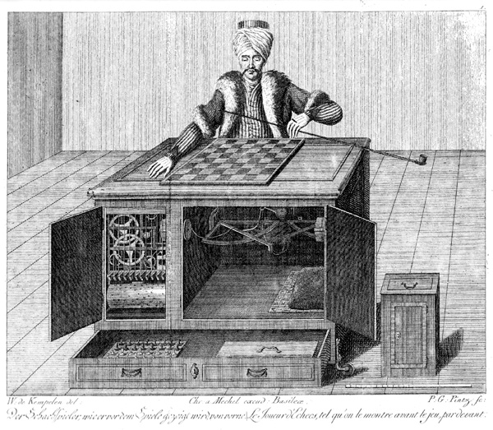
Notes:
Automaton Chess Player (German: Schachtürke, lit. 'chess Turk'; Hungarian: A Török), or simply The Turk, was a fraudulent chess-playing machine constructed in 1770, which appea

Slide 51
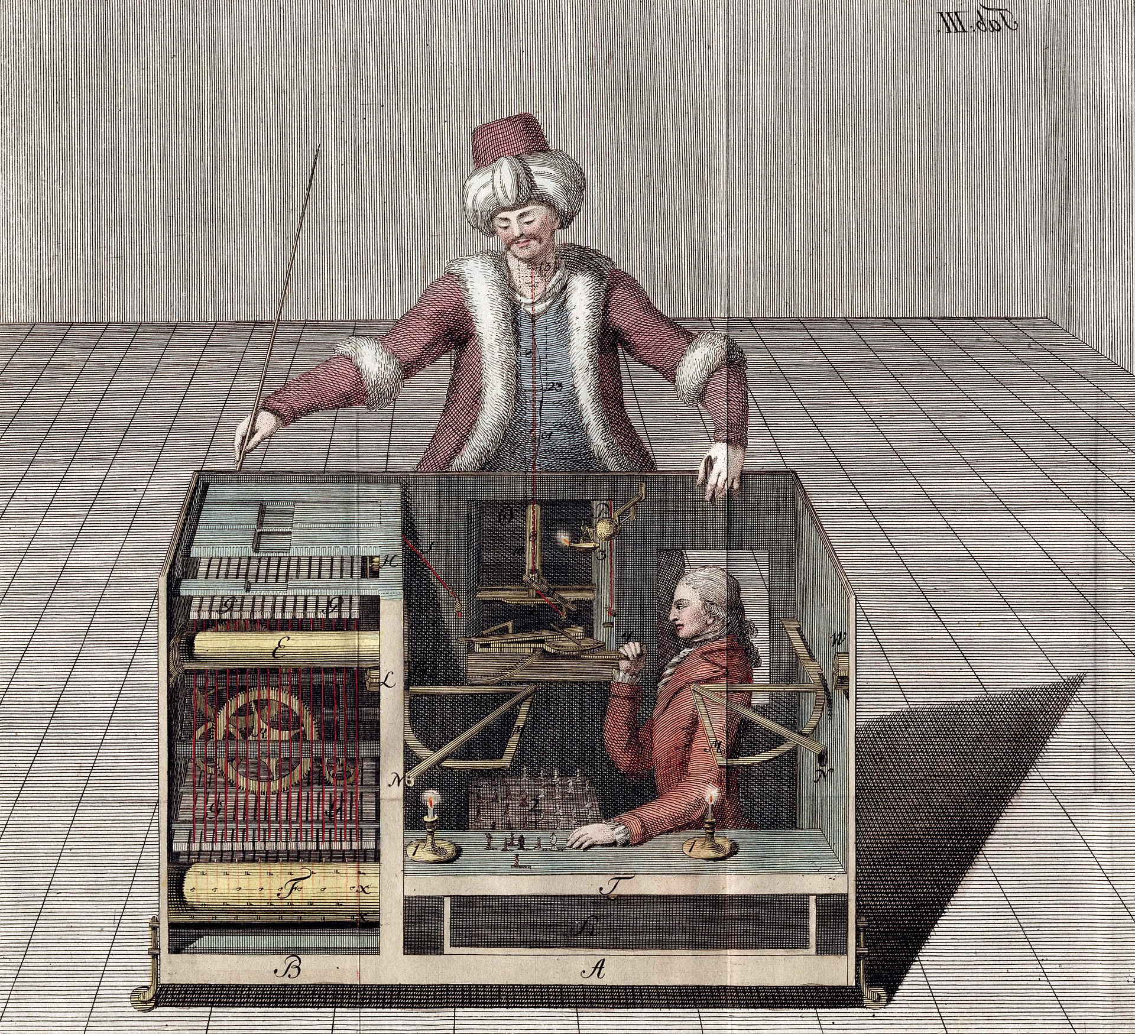

Slide 52
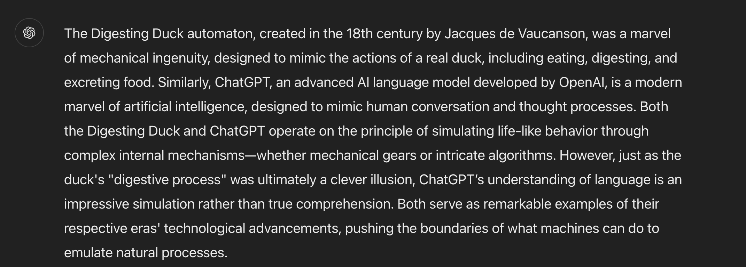
AI: An illusion?
Answer by ChatGPT

Slide 53
The first vending machine

Slide 54

The first vending machine

Slide 55

Any sufficiently advanced technology is indistinguishable from magic

Slide 56
AI: Magic?
Magic is done by magicians
Magicians (AI scientists and big-tech) can get in a position of privilege and abuse
Understanding AI and opening the black-box is important
Common people also need to understand what is AI

Slide 57

Should not substitute people with AI
Fujitsu scandal
Prosecutions and Convictions: Based on the evidence provided by the faulty Horizon IT system, the Post Office prosecuted around 736 postmasters for theft, fraud, and false accounting. Many of these individuals were convicted, with some even serving prison sentences.
For years, postmasters insisted that they had not committed any crimes and that the discrepancies were due to issues with the Horizon system.
However, their concerns were dismissed by the Post Office, which relied on the Horizon system's data to assert their guilt.
Takeaway: Decisions should be made by people, not machines

Slide 58
Big tech in AI: boon or curse?
Big tech
Creates jobs
Too much power getting concentrated in the hands of a few companies
We do not want a repeat of the East India company

Slide 59
Future Directions
Explainable AI
Human AI collaboration

Slide 60
My journey and personal experiences

Slide 61

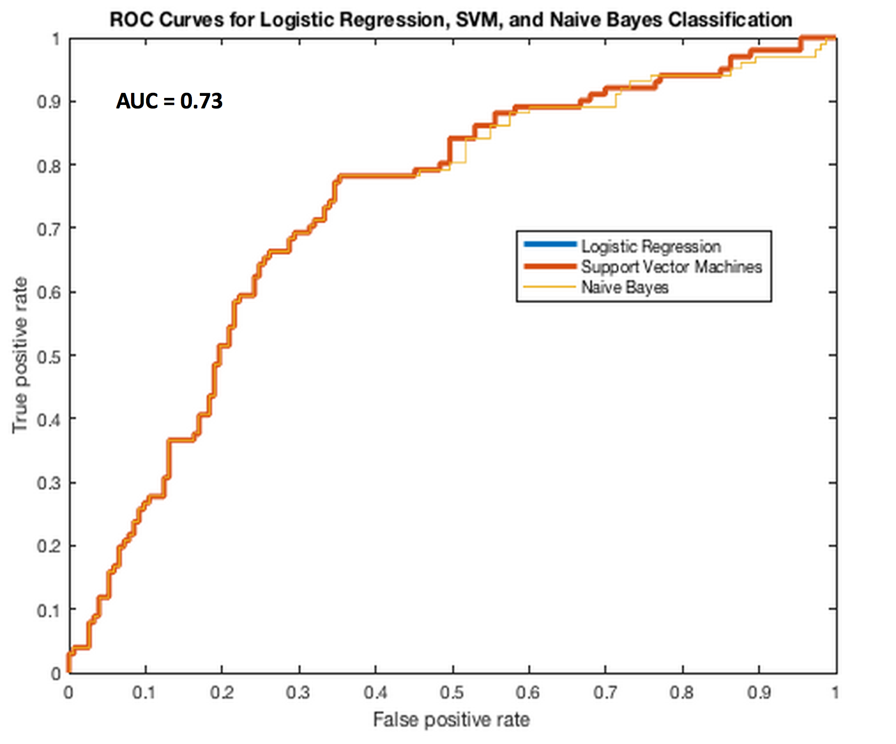

Clinical Informatics for Serious Illnesses
Clinical genomic data
Machine Learning
Stratify patients
Anonymization and security procedures
Clinical metadata
Input from domain experts (clinicians, statisticians, patients)

Slide 62
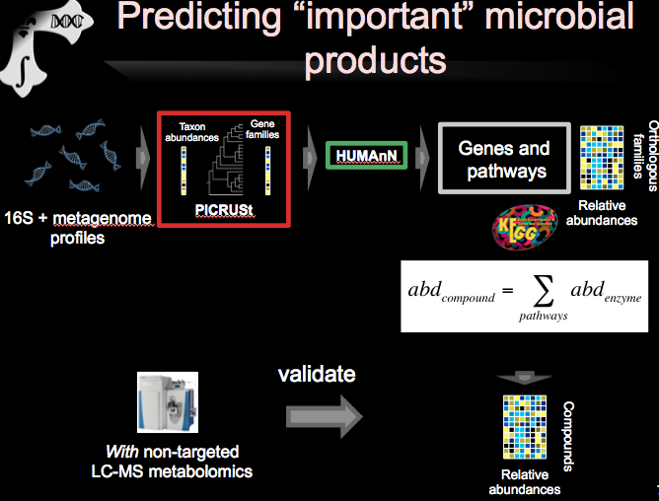
Nature Communications, 2019 (Nature publishing group), Impact factor = 14.9

Slide 63

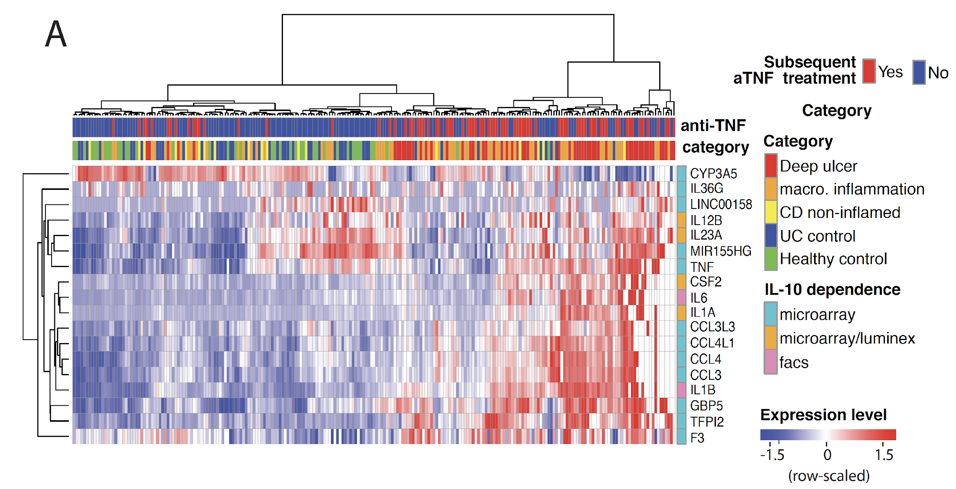

Using machine learning algorithms to predict disease
Gut, 2020 (British Medical Journal publishing group), Impact factor = 19

Slide 64
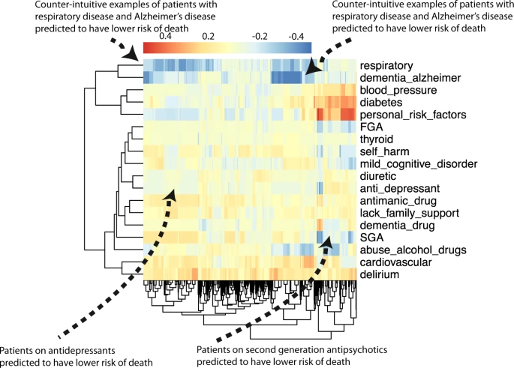
Interpretable machine learning
NPJ Schizophrenia, 2021 (Nature Partner Journal), Impact factor 6.6

Slide 65
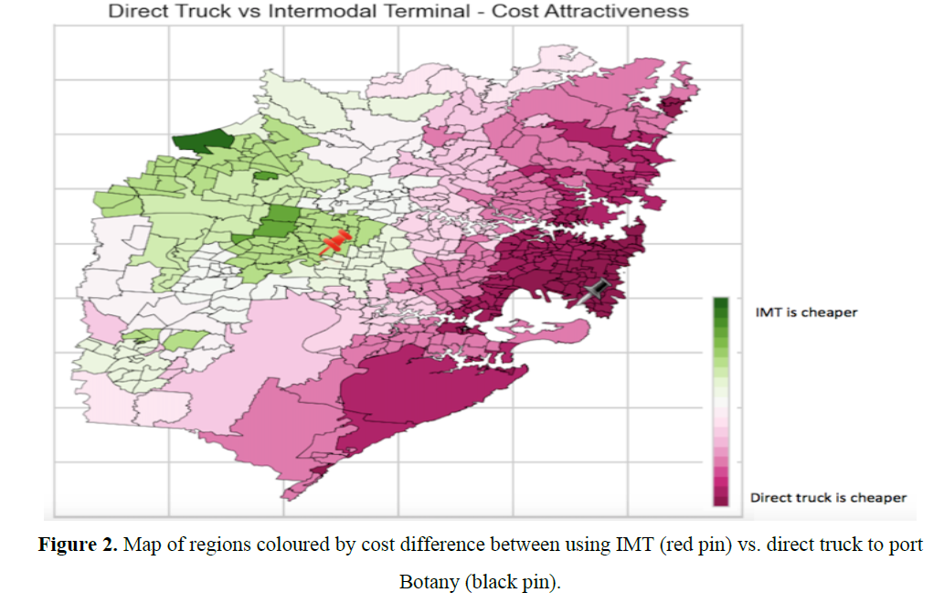
Using machine learning in supply chains
Notes:
In industry people work together

Slide 66
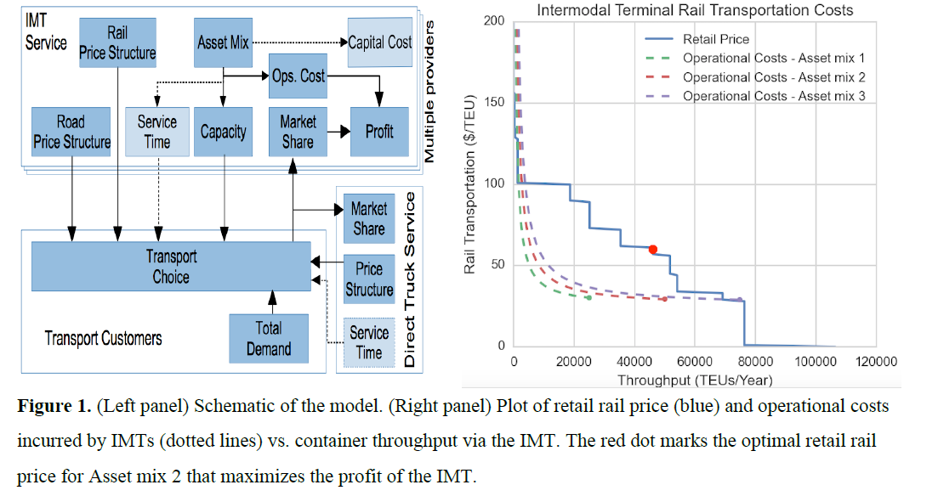
Using machine learning in supply chains
Notes:
forecasting and simulators linked to commercial data from companies

Slide 67
Explainable AI

Slide 68
The case of lithium
Lithium equation
Look into data
Sources of data
Explained simpler models first
Saga of data access ….
Validation ….

